Slide 1
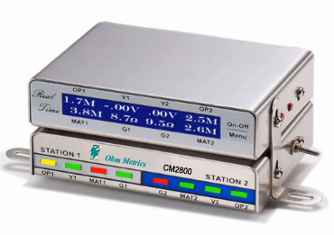
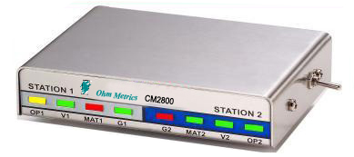
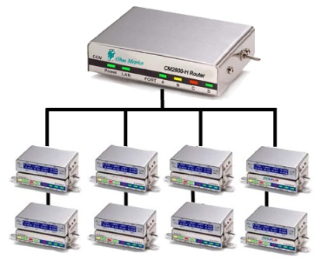
Ohm Metrics
CM2800 Series
ULV Digital
Dual Workstation Monitor and Network
©2011 All Rights Reserved

Slide 2
A Quick Comparison of
Wrist-Strap Monitoring
Technologies
Review of Wrist Strap Monitoring Technologies
2800 Series Resistance Monitor
  Features & Benefits
  Components
  Network
  Scalable Design
Market comparison
Summary

Slide 3
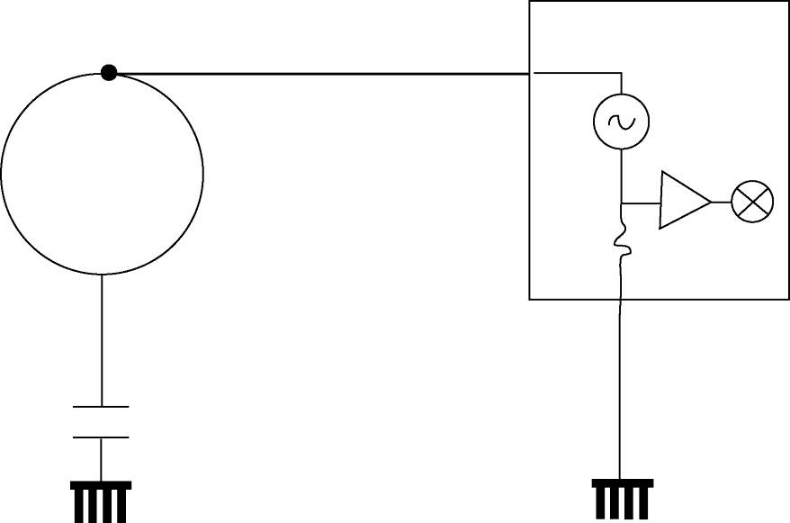
Impedance Monitoring
Monitor
Impedance Monitor
Impedance monitors use single conductor wrist strap technology. They monitor current through the capacitive coupling of the operator to ground.
I
Advantages
Uses single wire wrist strap technology that is widely available and inexpensive.
Human Body
Problems
1. Less reliable than resistance monitoring. A wrist strap worn over the sleeve may still give adequate capacitive coupling even though operator is not grounded.
2. Technology has limited capability to accurately monitor different human body types . May trigger false alarms.
Examples
Many available ones in the market are of this kind.
1

Slide 4
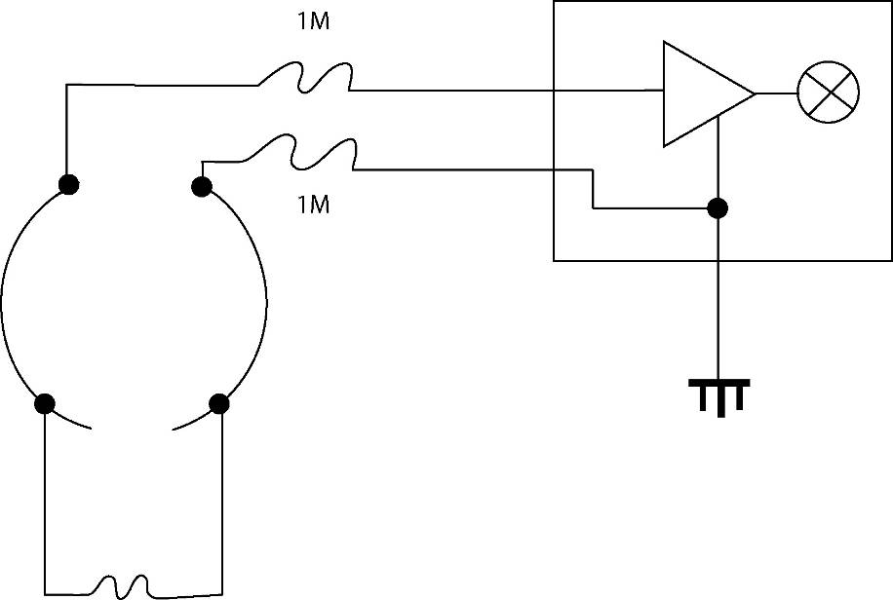
Voltage Monitoring
Voltage Monitor
Voltage monitors use dual wrist strap technology. They ground the operator with one wire and monitor operator voltage with the second conductor.
Monitor
Service Wire
Advantages
Alarms if operator voltage exceed set threshold.
Problems
Voltage monitors may not alarm, if voltage on the operator is below the alarm threshold, even when a ground wire is disconnected. Alarms are triggered after the event.
Ground Wire
Disadvantage
Costly compared with impedance technology
Human Body
Example
3M WS Aware.
2

Slide 5
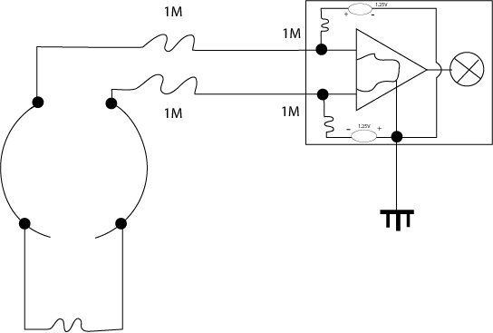
Resistive Loop Monitoring
Resistive Monitor
This device uses dual wrist strap technology. Resistive loop monitors measure operator resistance and ground the operator with both wires.
Service Wire
Monitor
Advantages
1. Will alarm if operator loses contact with one ground wire.
2. Monitors low limit resistance (2M) and high limit
(10M or 35M); assures safety of product and operator.
Service Wire
Problems
None identified.
Disadvantage
Cost – compared to impedance technology.
Human Body
Example
CM2800, CM2815, 3M WS Aware.
3

Slide 6
CM2800 Series Monitors
Features and Benefits
Measures digital values for Resistance and Voltage
Monitors Operator Resistance, Operator Body Voltage
Mat Resistance
Machine Resistance
Selectable Test Limits
Ultra Low Body Voltage
Built-in Network Connection
Operator-Presence-Check with time control
Supports External Interface
Scalable
Accurate
Standard
Standard (Optional for some Alias)
Standard
Standard (Optional for some Alias)
Meets S20.20 and IEC-61340
< 100mV worst case
All models are Network Ready
One measure of workforce presence
Centralize, collect and share data
Upgrade, add features as needed

Slide 7
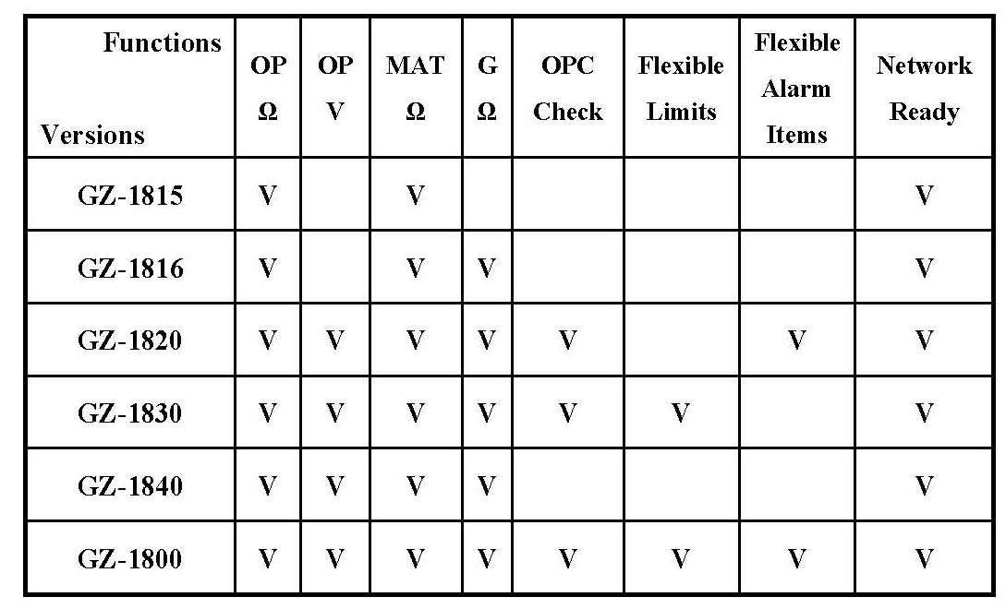
CM2800 Series Options
CM2815
CM2816
CM2820
CM2830
CM2840
CM2800

Slide 8
CM2800 Series: HARDWARE
Core Product:
CM2800
Digital Set:
CM2800 + CM2800D

Slide 9
CM2800 Series: HARDWARE
Menu & Display Mode
Switch
Digital Display
LCD Panel
Power Switch
3-color LED
Status Indicators

Slide 10
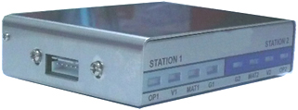
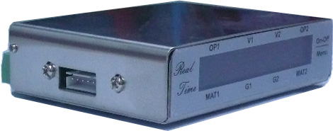
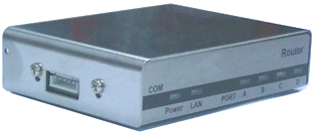
CM2800 Series: HARDWARE
CM2800 COM port:
to connect to a relay-box
CM2800D COM port:
reserved for open-collector outputs
CM2800H COM port:
to connect to a wireless transceiver

Slide 11
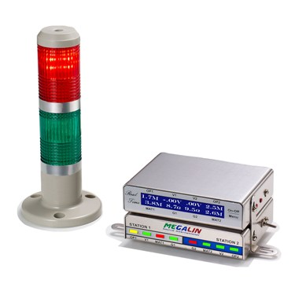
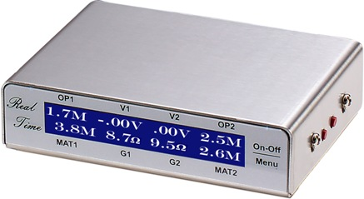
CM2800 Series: HARDWARE
CM2800D:
Digital Display and
External Control Module
CM2800CS Complete Set
With an External Siren
Digital LCD
Display
Menu &
Mode Switch

Slide 12
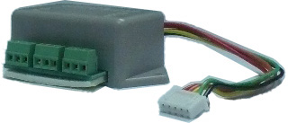
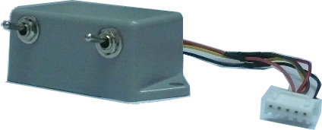

CM2800 Series: HARDWARE
CM-RELAY:
External Relay Box
CM-SPLIT:
Monitor Splitter Box
CM2800D: Digital LCD
Display

Slide 13
CM2800 Series: Network
CM2800H:
Network Router
4 Network Ports:
Each Port Supports 128
CM-2800 Digital Monitors

Slide 14
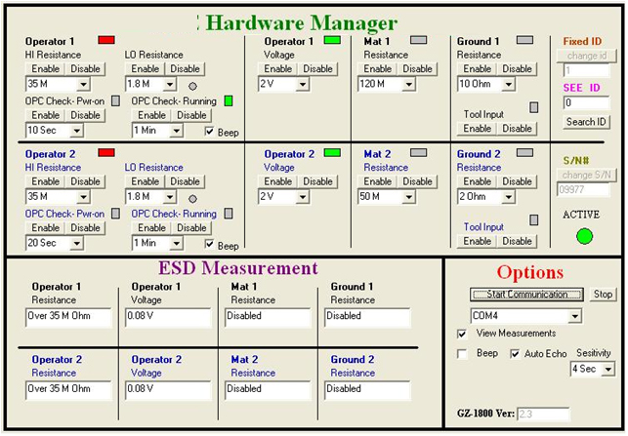
CM2800 Series: SEE Software
Selection Menu and Current Status
Control
Real-time Values Display

Slide 15
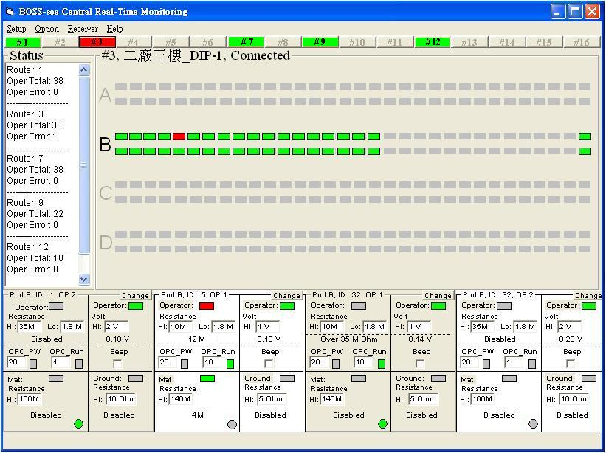
CM2800 Series: Network Software
Router
Watch
Bar
Main
Screen
Overall
Status
Screen
4 Workstation Watch Windows

Slide 16
CM2800 Series Options
Scalable Design
CM2815
CM2816
CM2820
CM2830
CM2840
CM2800

Slide 17
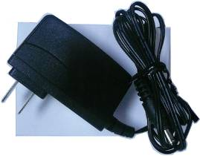
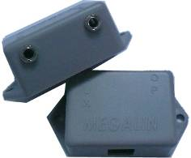
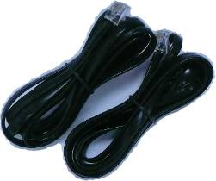

CM2800 Series: Complete Package
Standard Package:
Monitor Unit + Power Supply + Remote Jack + Connection Wire
Optional:
  Digital Display & External Control Module: CM2800D
  Hardware Management Program: CM2800-SEE
  Dual-wire Wrist Strap Set

Slide 18


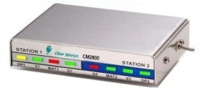
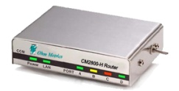
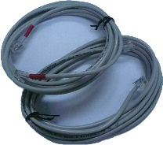
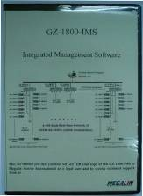
Network Package: Typical Set
Multiple Complete Monitor Units
+ Network router
+ Connection Cables
+ BOSS-see Network Management Programs
∙ ∙ ∙
∙ ∙ ∙
∙ ∙ ∙

Slide 19
Accessories
Digital Display & External Control Module: CM2800D
Hardware Management Program: CM2800-SEE
Calibration RBOX: CM2015PV
Network connection cable: CM-485CABLE
External Relay Box: CM-RELAY
Monitor Splitter Box: CM-SPLIT

Slide 20
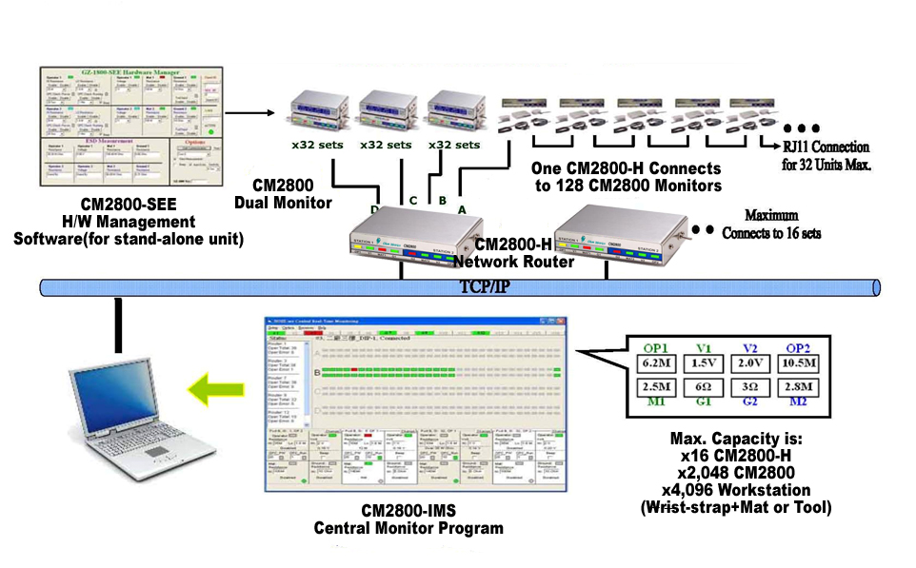
A CM2800 Network Via TCP/IP LAN

Slide 21
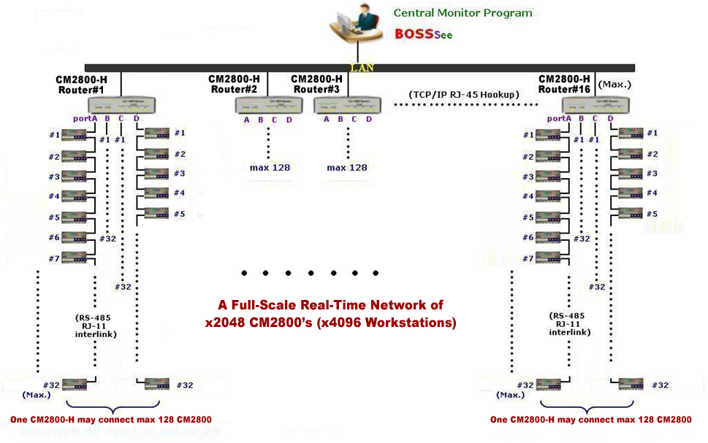
A CM2800 Network Infra Structure

Slide 22
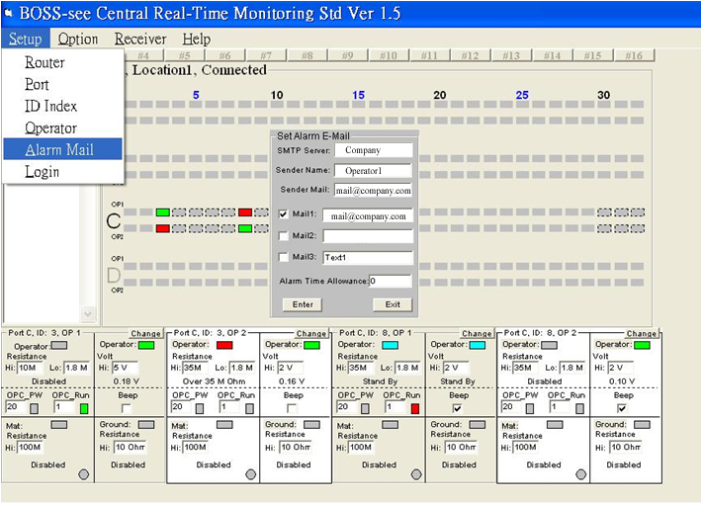
BOSS-see® Central Real-Time System

Slide 23
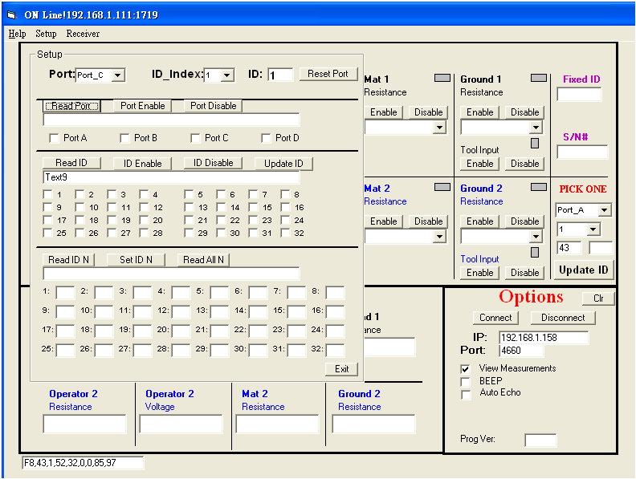
BOSS-see® Installation Setup Program
Target
Monitor
Verify
Connect
Command
Buttons
Display
Boxed
Network Connection

Slide 24
Proactive Workstation
Ground Monitoring System
Management Software

Slide 25
Selections To Meet Your Needs
For Stand-alone systems and Networks
CM2800-SEE：
  for the control of stand-alone hardware unit
  for delicate setting & observation of internal parameters
2. BOSS-see (CM2800-IMS)：
  for the central monitoring of a network of CM2800’s
  for real-time management of 4096 workstations
  Measure-man: instant massive measure-n-record of every workstation for paperless QC reports for audit
  includes the “BOSS-see Setup” system utility program

Slide 26
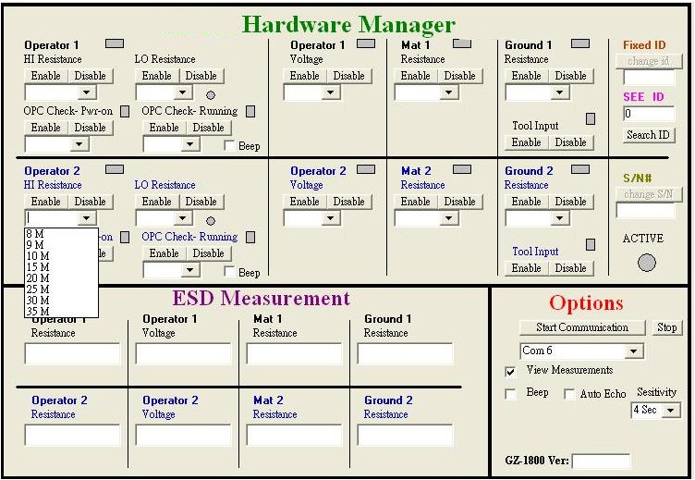
Stand-Alone Hardware Control: CM2800-SEE
3 main
sections

Slide 27
BOSS-see® : Network control (1/2)
Main
Setup
Menu

Slide 28
BOSS-see® : Network control (2/2)
Main
Screen

Slide 29



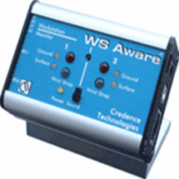
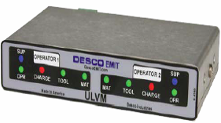
Market Key Players
Major Competitions
ULV Workstation Monitors
3M/Credence
CM2800
WS Aware
ULVM
* 3M/Credence is a brand name under 3M. ULVM is a product under Desco.

Slide 30
Overall Comparison (1)
(Proximity Card System) | Ohm Metrics | 3M/Credence *
Model Name | CM2800 | WS Aware
Proactive Monitoring | Yes, with strong software features | Hardware-based
Overall Hardware | Advanced SMT | SMT
Overall Software | Strong DIY software | Nil
Network Capability | 4096 workstations | Small hub group
Site Installation | Simple and quick | Proprietary and complex
After-sales Service | DIY or local service | Heavily rely on agents
* 3M/Credence is a brand name under 3M
Notes:
Desco/Semtronics Smartlog X3 list price: #1~#4: $4,692 #1~#5: $7,999
Smartlog X3 $2,861
Proximity card reader: H/W cost $1,000; installation fee $500
RS485/232 converter or Ethernet adaptor: $331
Basic Smartlog software: $0
Enterprise software: $3,307
Megalin GZ-300 list price: $3,150
GZ-300: $2,150
ML-JAS1000E: $1,000

Slide 31
Major Pros & Cons Comparison (1)
BRANDS ITEMS | Ohm Metrics CM2800 | 3M/Credence * WS Aware
Digital Result Display On Site | Yes** | No
Programmable Alarm Items | Yes | Yes, need extra H/W
Programmable Test Limits meeting S20.20 / IEC-61340 | Yes | Yes, need extra H/W
User Program Interface | Yes | No
Operator Presence Check | Yes | No
Instant Measure-n-Record | Yes | No
DIY Network Ready | Yes | No
*3M/Credence is a brand name under 3M
**Optional
Notes:
Desco/Semtronics Smartlog X3 list price: #1~#4: $4,692 #1~#5: $7,999
Smartlog X3 $2,861
Proximity card reader: H/W cost $1,000; installation fee $500
RS485/232 converter or Ethernet adaptor: $331
Basic Smartlog software: $0
Enterprise software: $3,307
Megalin GZ-300 list price: $3,150
GZ-300: $2,150
ML-JAS1000E: $1,000

Slide 32
Some CM2800/CM2000 Series Customers
Foxconn/CMO: LCD panel
SPIL : World leader of IC packaging/testing
Samsung : Electronics Manufacturing
INVT : Leader of frequency inverters in China
Notes:
Desco/Semtronics Smartlog X3 list price: #1~#4: $4,692 #1~#5: $7,999
Smartlog X3 $2,861
Proximity card reader: H/W cost $1,000; installation fee $500
RS485/232 converter or Ethernet adaptor: $331
Basic Smartlog software: $0
Enterprise software: $3,307
Megalin GZ-300 list price: $3,150
GZ-300: $2,150
ML-JAS1000E: $1,000

Slide 33
CM2800 Excellence In Summary
Superior performance/price ratio.
Technologically based with unique product features.
Committed to providing the best value solution to
our customers.
Technology, Performance,
Quality, Service …

